Slide 1

PRESENTATION OF PROJECT
BD EMR
PRESENTED BY
Bit & Byte

Slide 2
COURSE TITLE: SOFTWARE DEVELOPMENT 1
COURSE CODE :
CSE -1240
COURSE TEACHER :
MD. Shofi Uddin

Slide 3
WHAT IS EMR ?
An electronic medical record (EMR) is the systematized collection of patient and population electronically stored health information in a digital format. These records can be shared across different health care settings. Records are shared through network-connected, enterprise-wide information system or other information networks and exchanges. EMRs may include a range of data, including
Medical history,
Demographics,
Medication and allergies,
Immunization status,
laboratory test results etc

Slide 4
Why BD EMR?
Providing accurate, up-to-date, and complete information about patients at the point of care.
Enabling quick access to patient records for more coordinated ,efficient care.
Securely sharing electronic information with patients and other clinicians.
Helping providers improve productivity and work life balance.
Reducing costs through decreased paperwork, improved safety, reduced duplication of testing, and improved health.

Slide 5
BD EMR
SOFTWARE MAPPING
FEATURES
USER INTERFACE

Slide 6
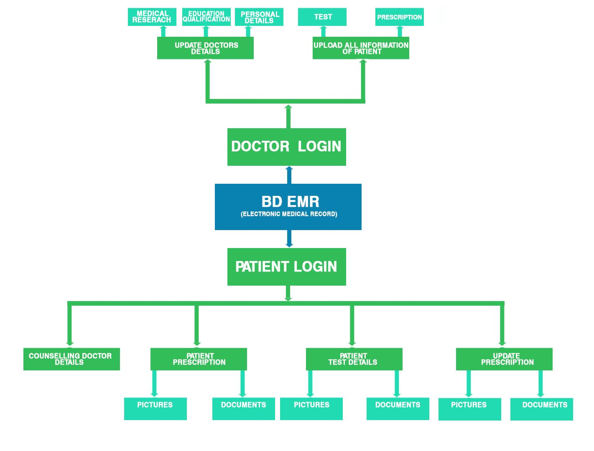
SOFTWARE MAP

Slide 7
FEATURE AND UI

Slide 8
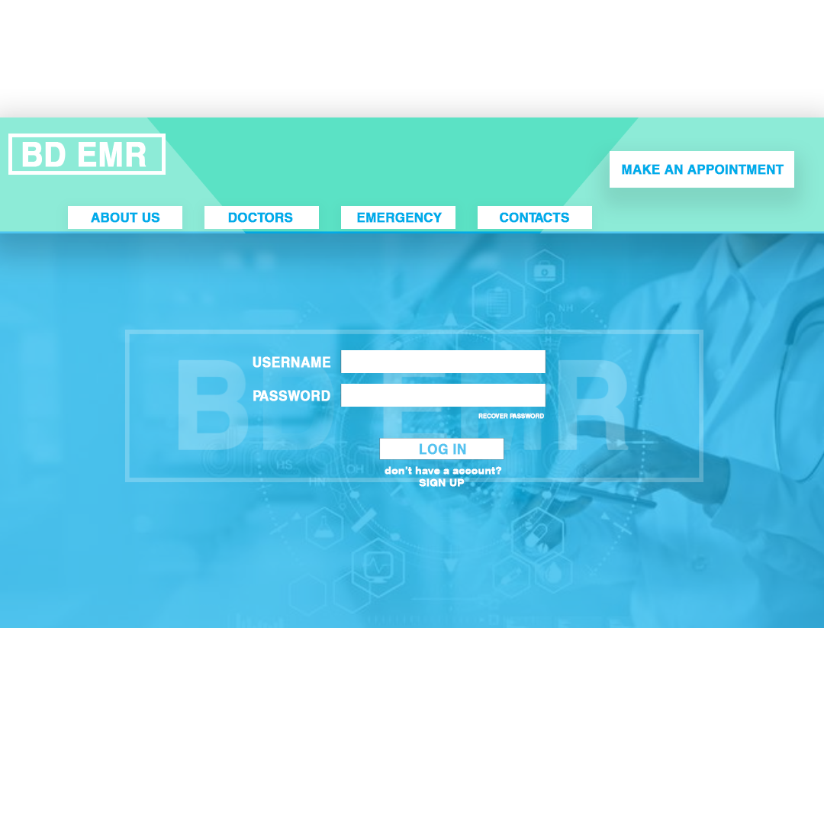
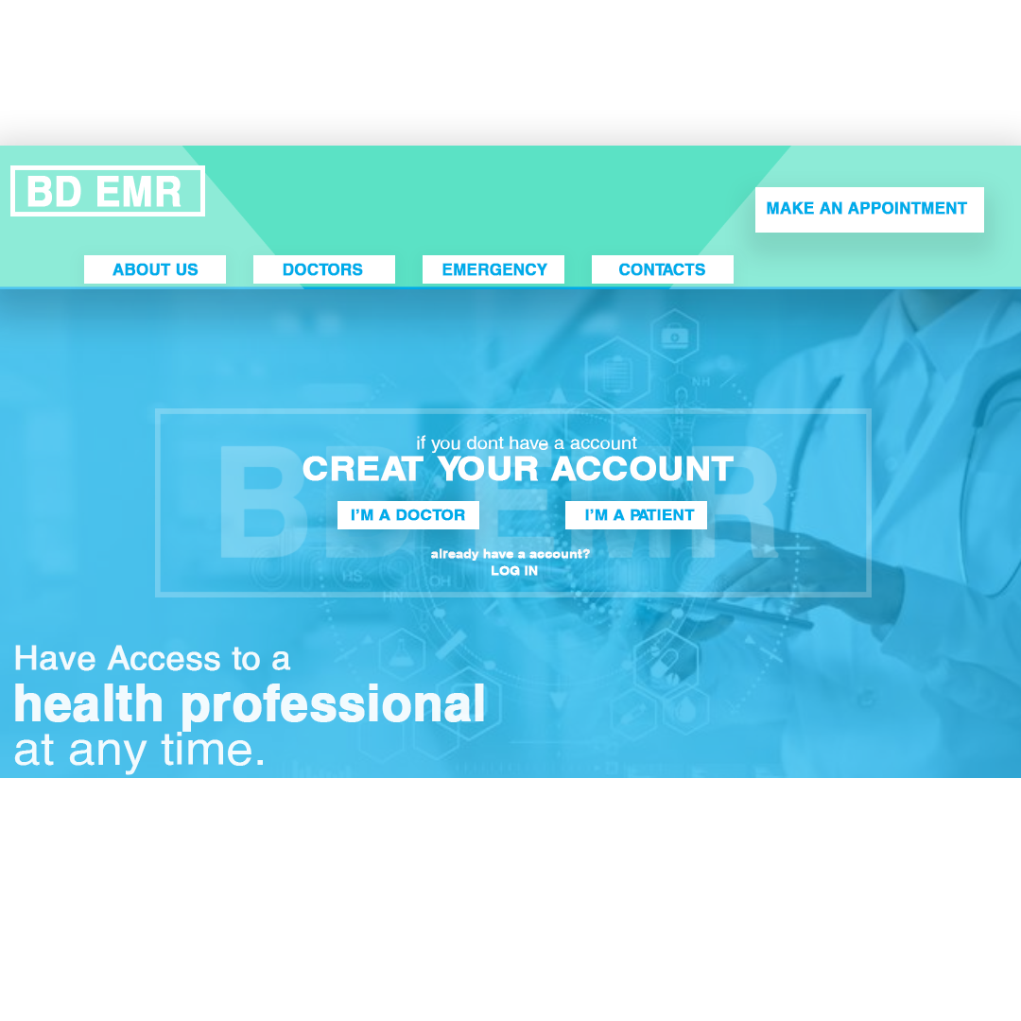
User Interface and Fetures
Users have to Log in or sign up to get the better experience of BD EMR by clicking log in or sign up option

Slide 9
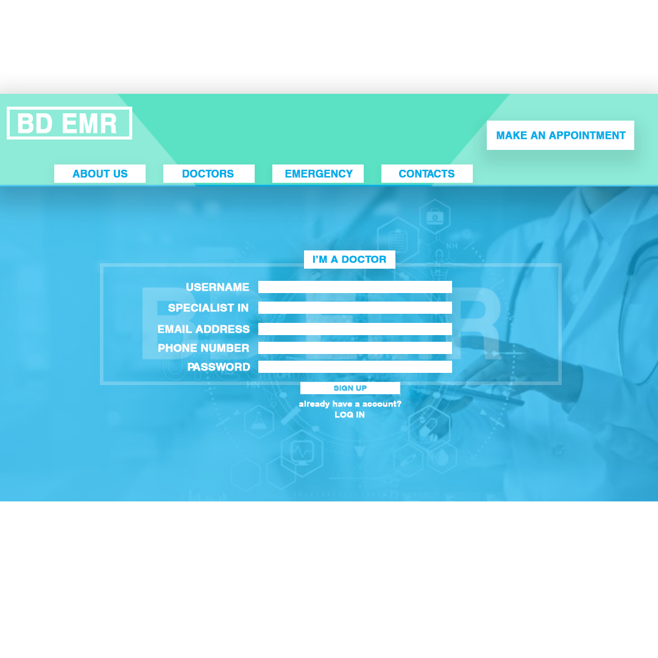

Users have to provide their unique username , location ,where he/she is specialist (For doctors) ,email address ,phone number and password to sign up

Slide 10
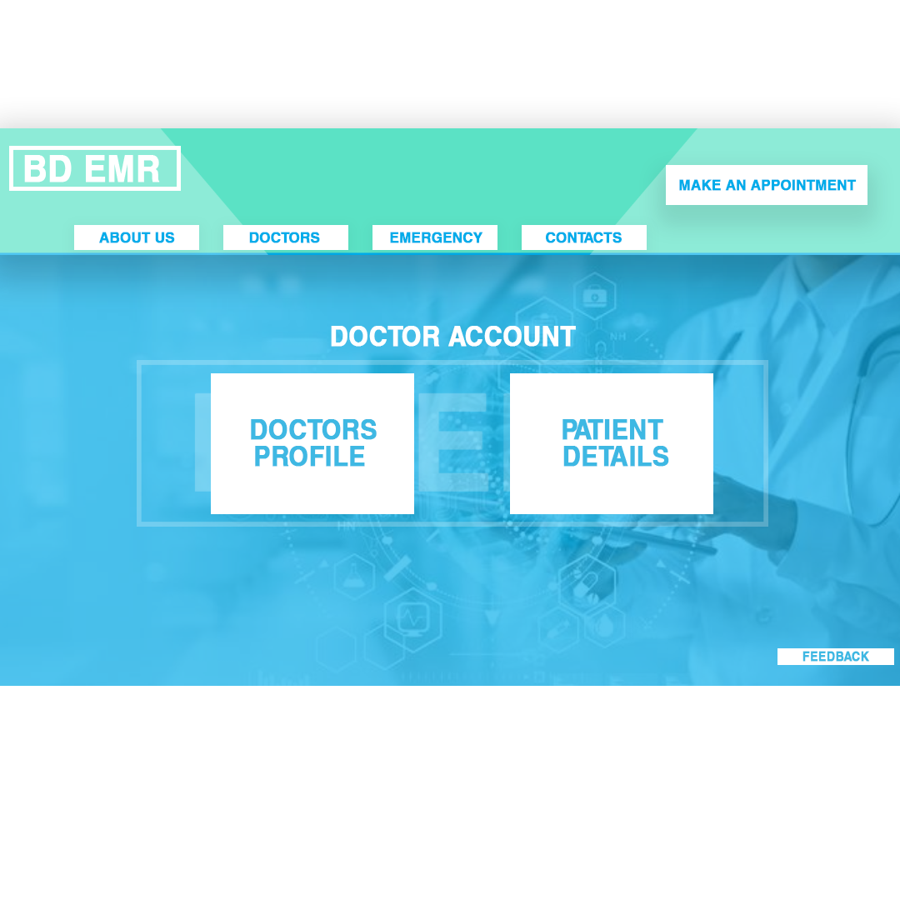
Features Doctor Profile

Slide 11
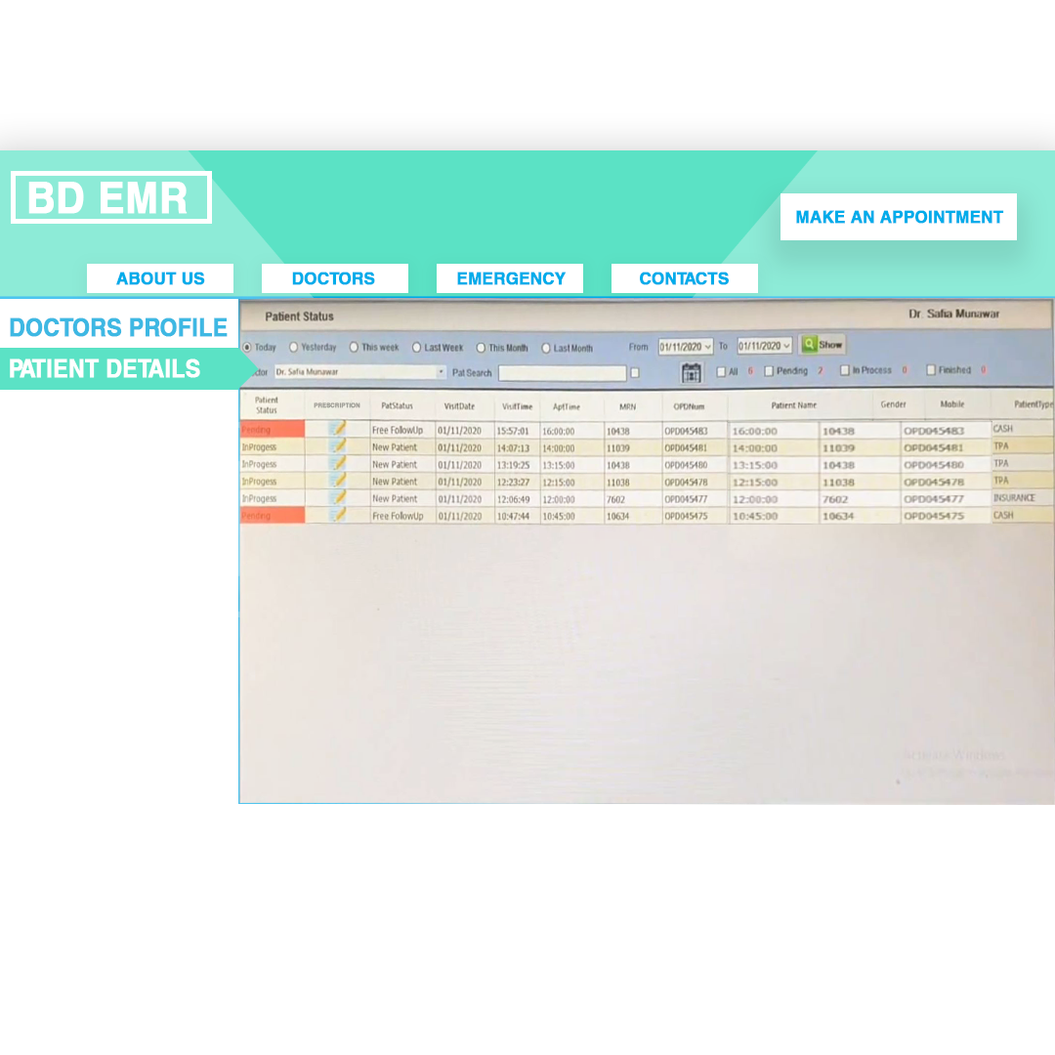
Doctors can check their patient list and update as per required by get in to patient details options

Slide 12
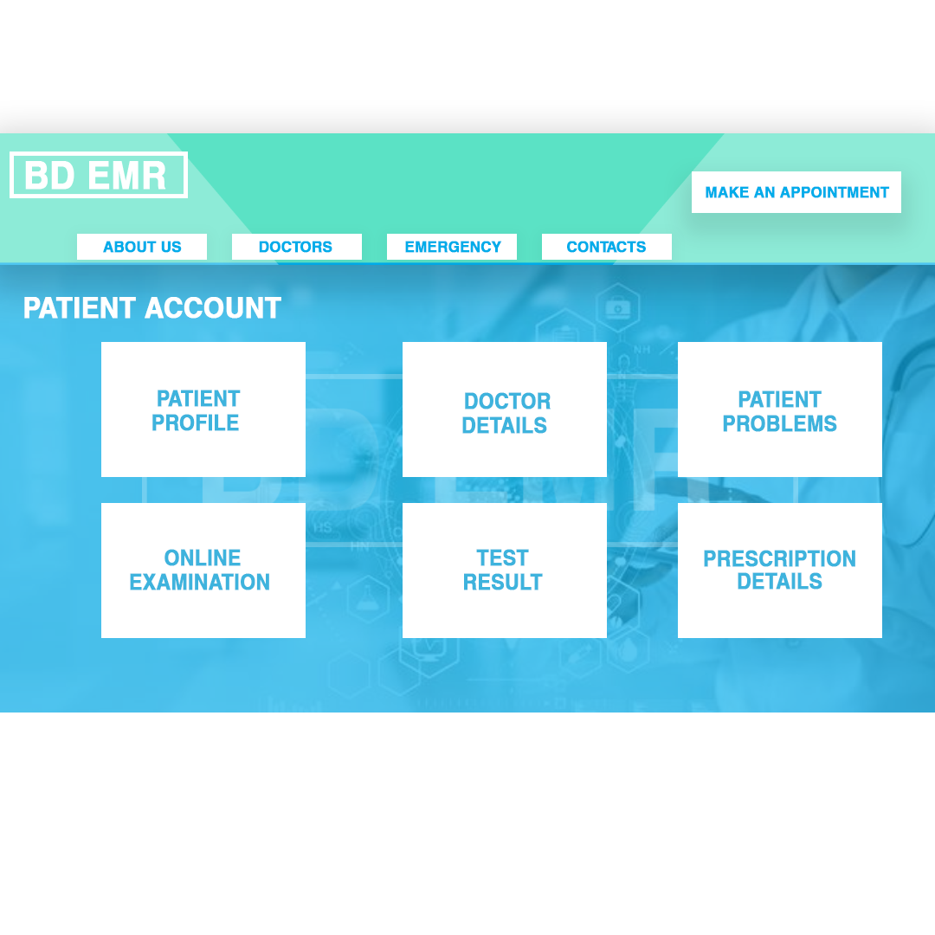
Patient Account

Slide 13
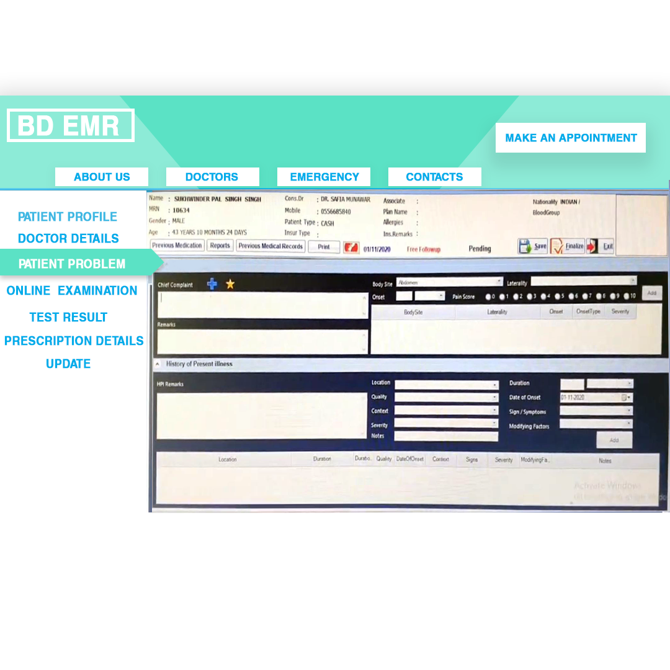
We added lot of feature in Patient Account so that patient can elaborate their problems as much as detailed possible and doctors can get proper information about their patient

Slide 14
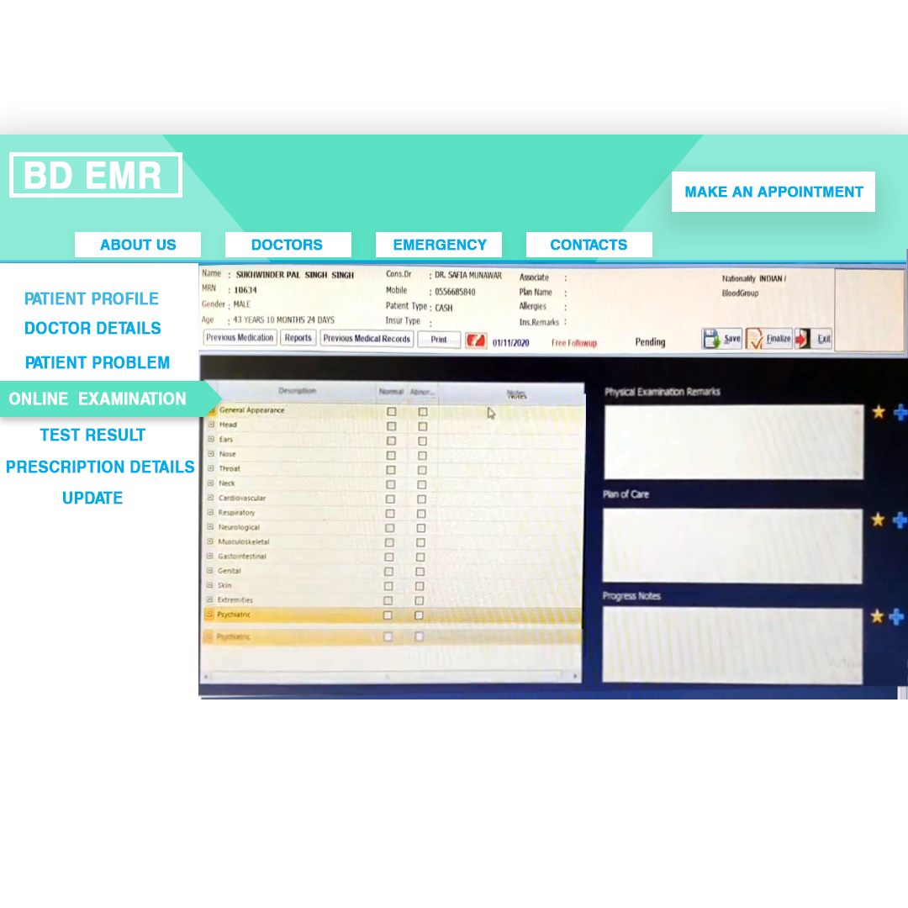
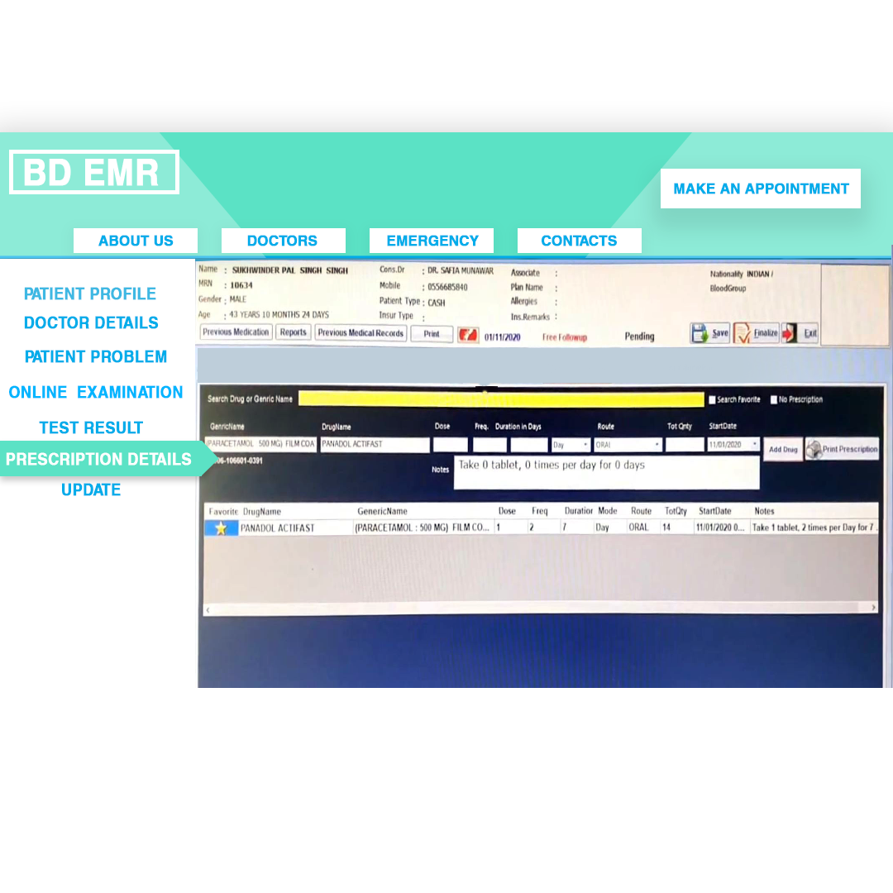
We also added an online feature “ONLINE EXAMINATION” where patient can test their health condition buy clicking some required options and also get old and updated prescription by clicking in “PRESCRIPTION DETAILS “

Slide 15
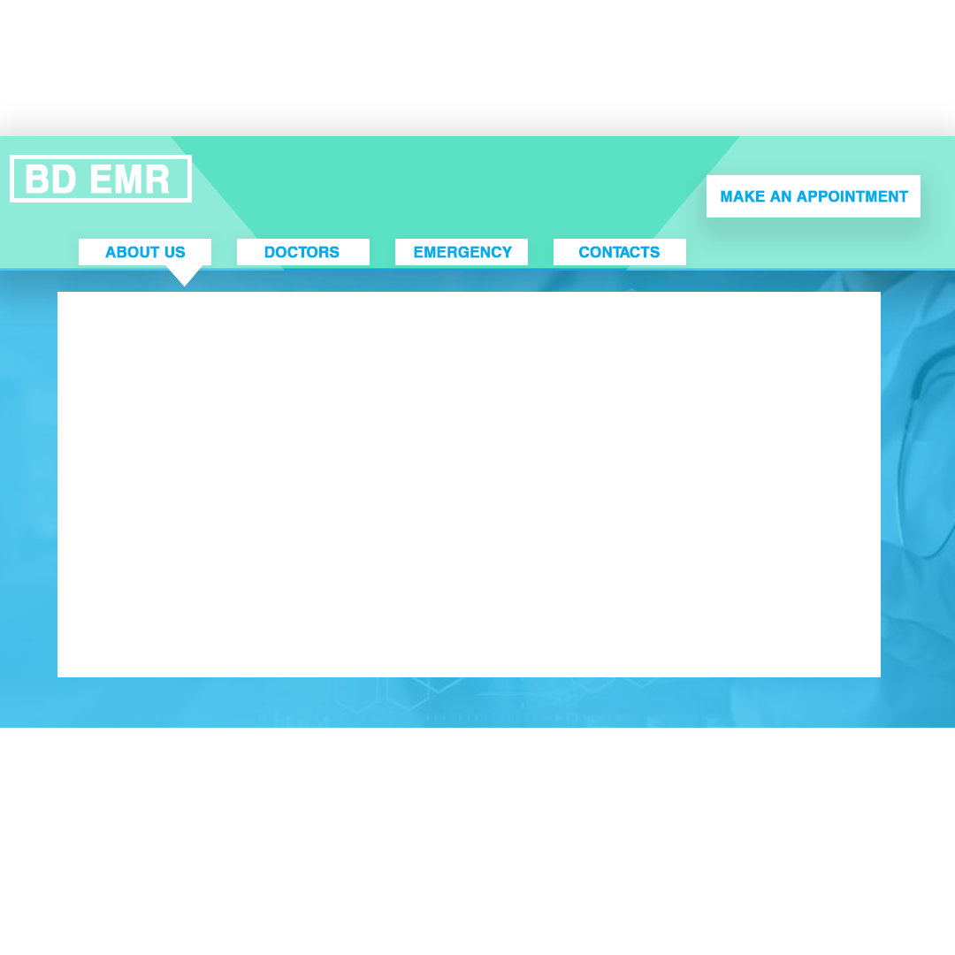
Our Team
Name: Md Ibrahim Shakib
ID: C191114
Name: Safaet Jaman Arman
ID: C191098
Name: Iftu Bin Misbah
ID: C191090
Name: Shamsuddin Ahmed Chy.
ID: C193064

Slide 16
THANK YOU

